Slide 1
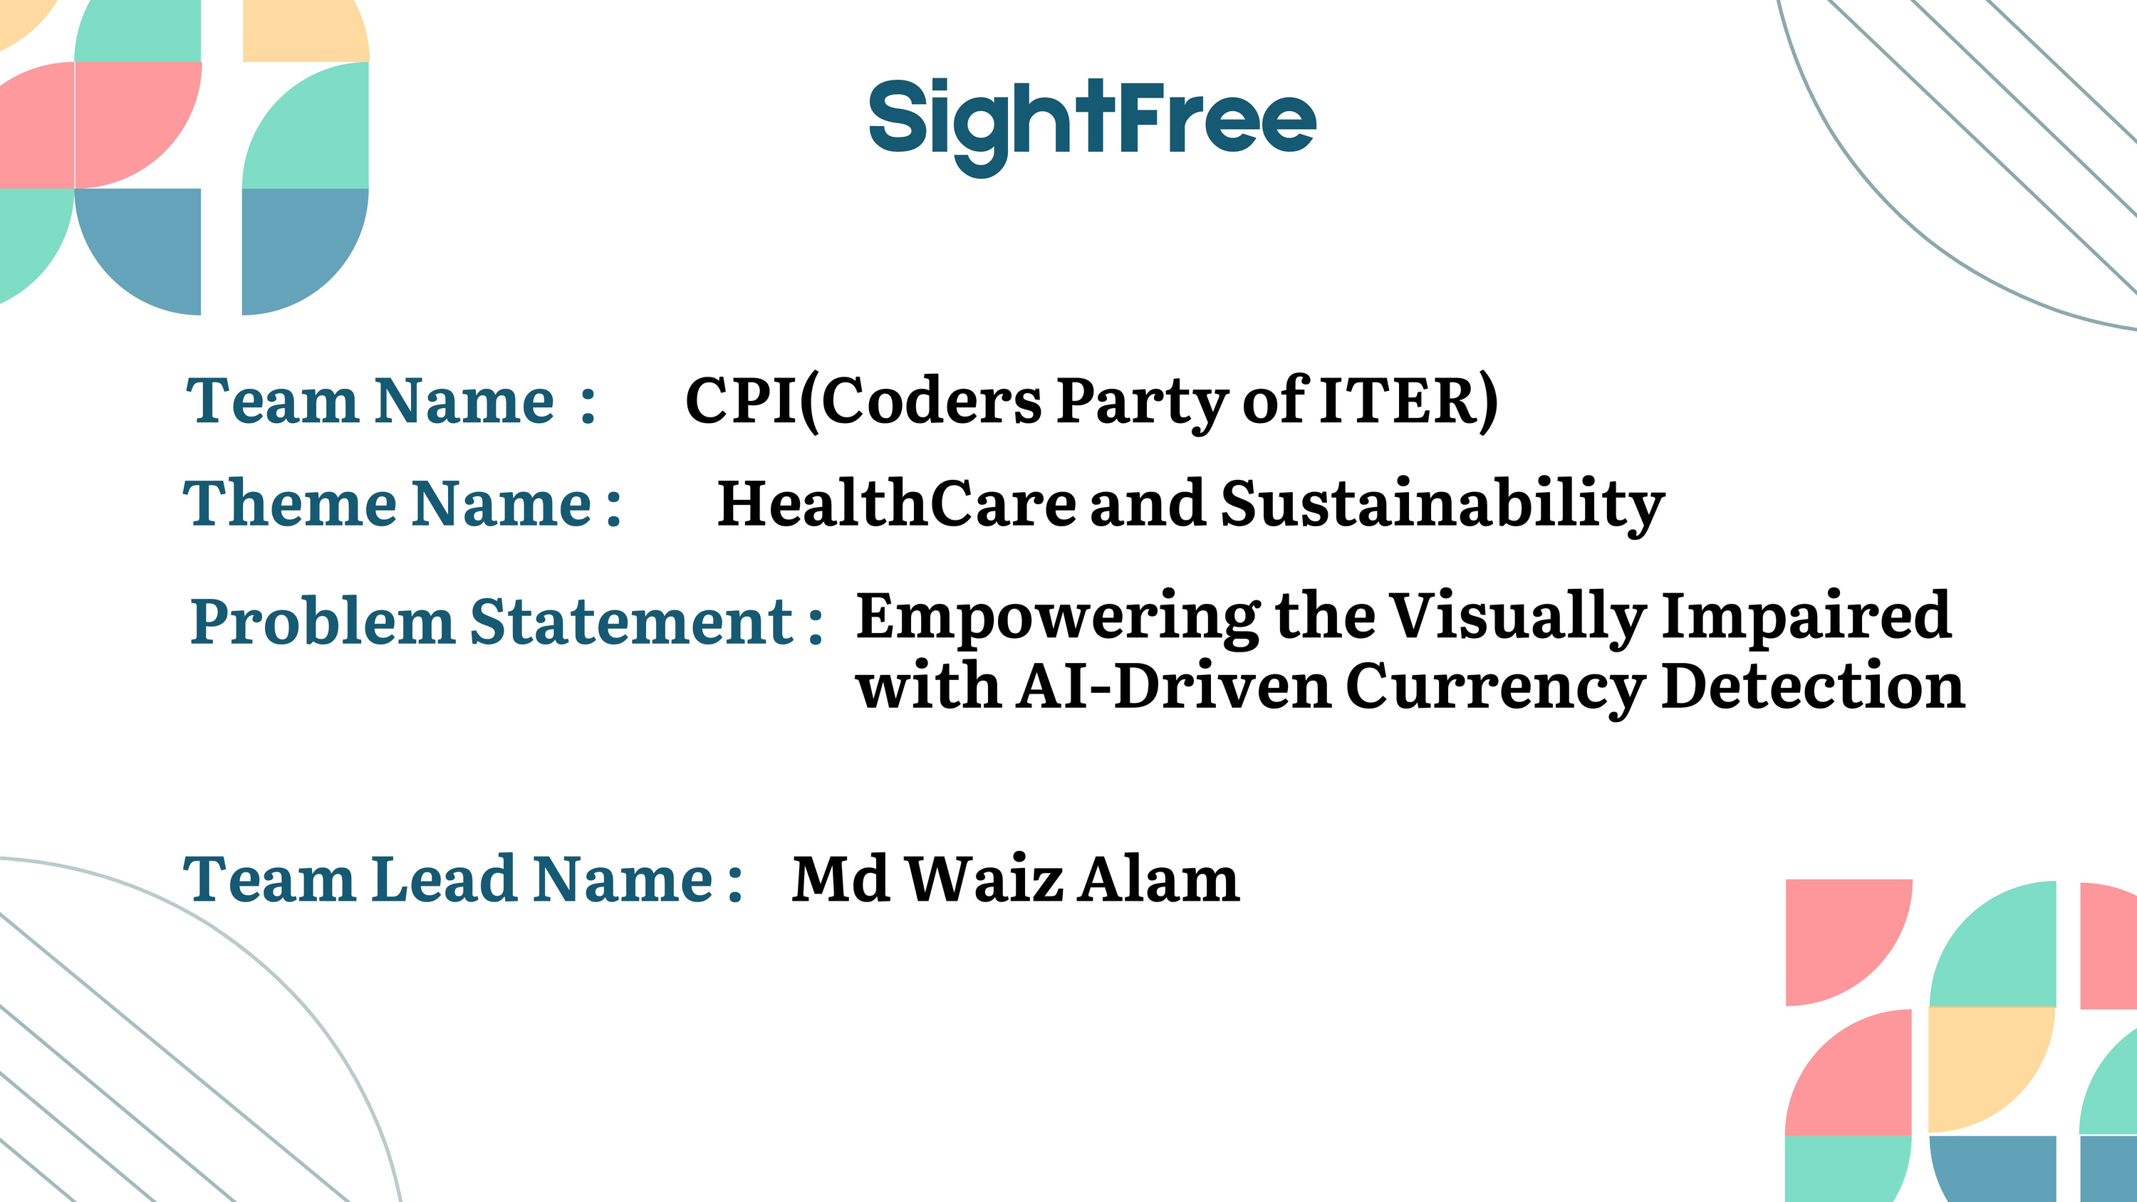
VisionAi
VisionAi
Team Astrix
& object detection

Slide 2
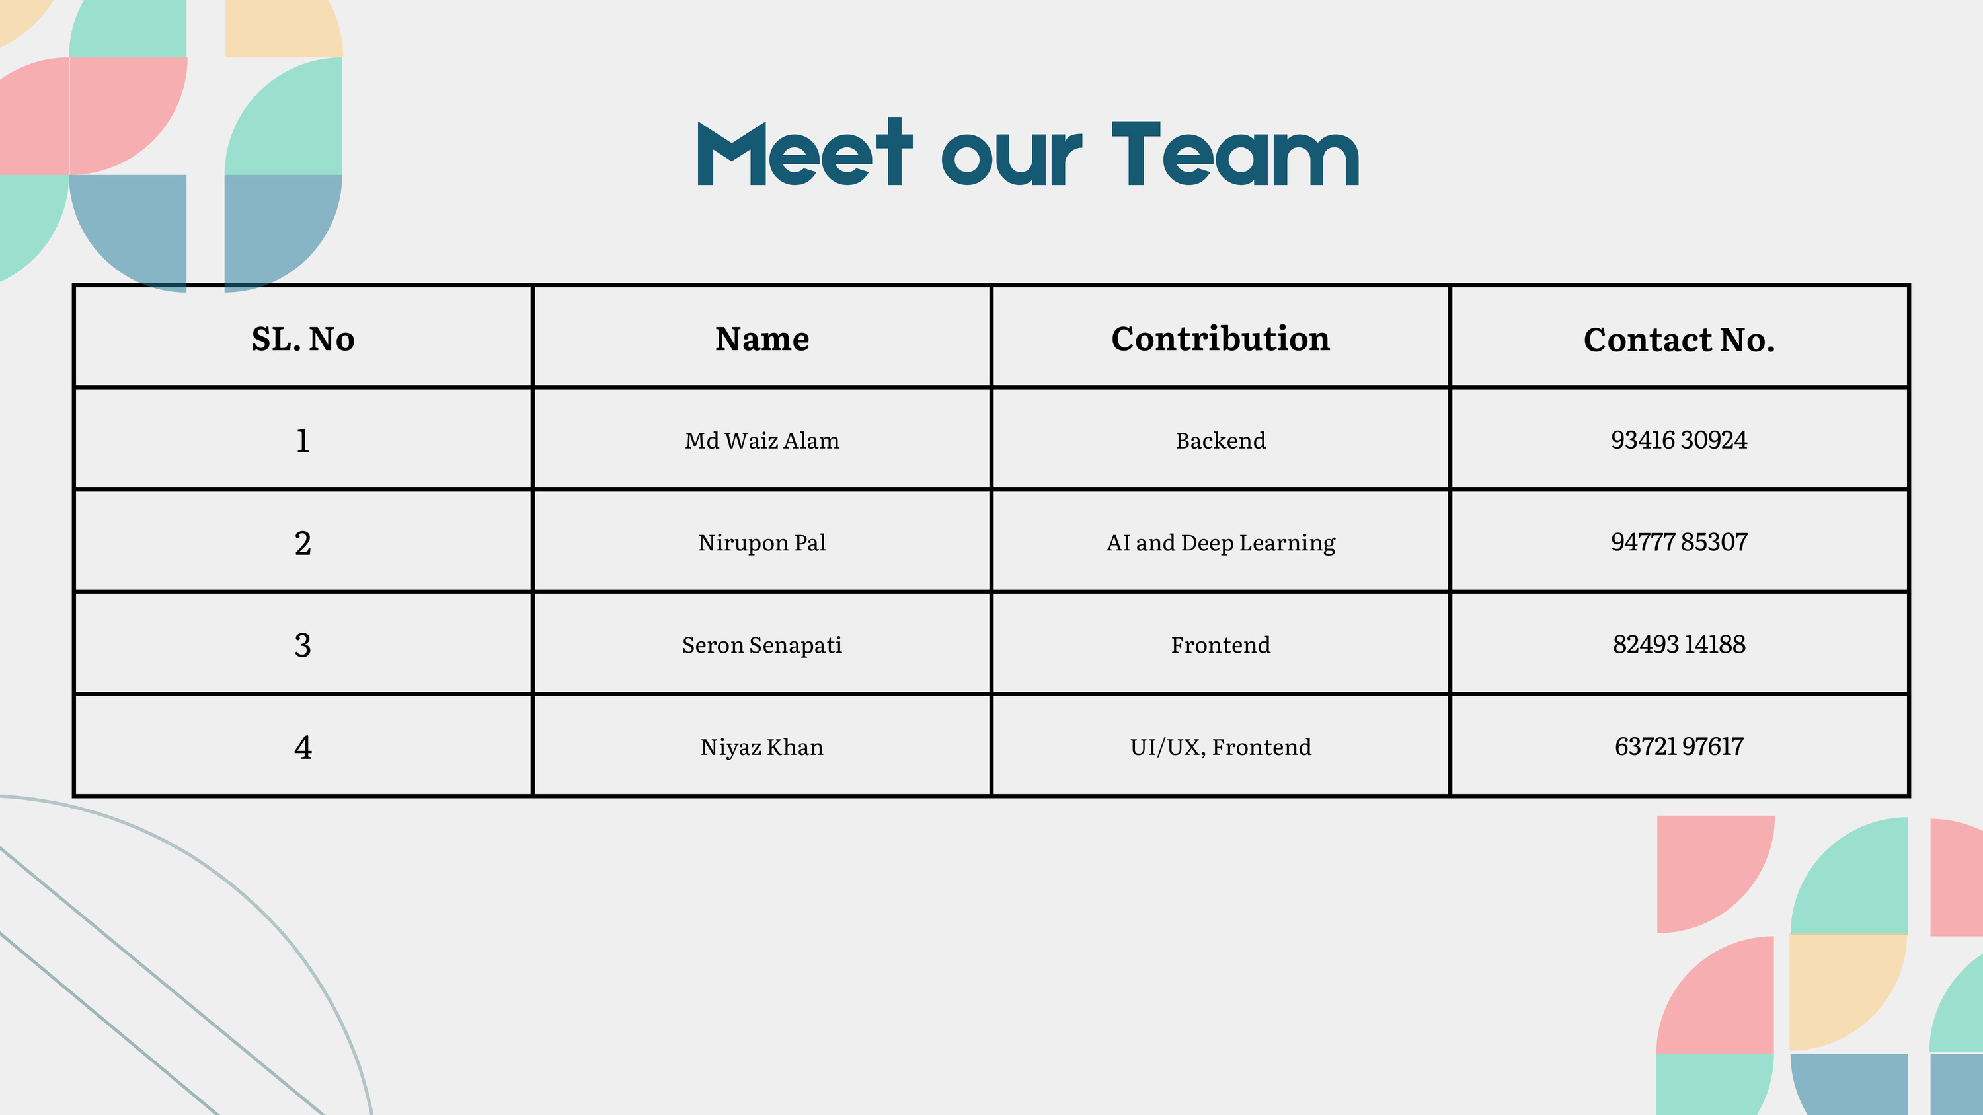
Abdul naved
UI/UX designer
6290335177
Aditi Kumari
Frontend
8809676850
Ariba Shakil
Frontend
9142733472
Md Waiz Alam
Backend + AIML
9341630924

Slide 3
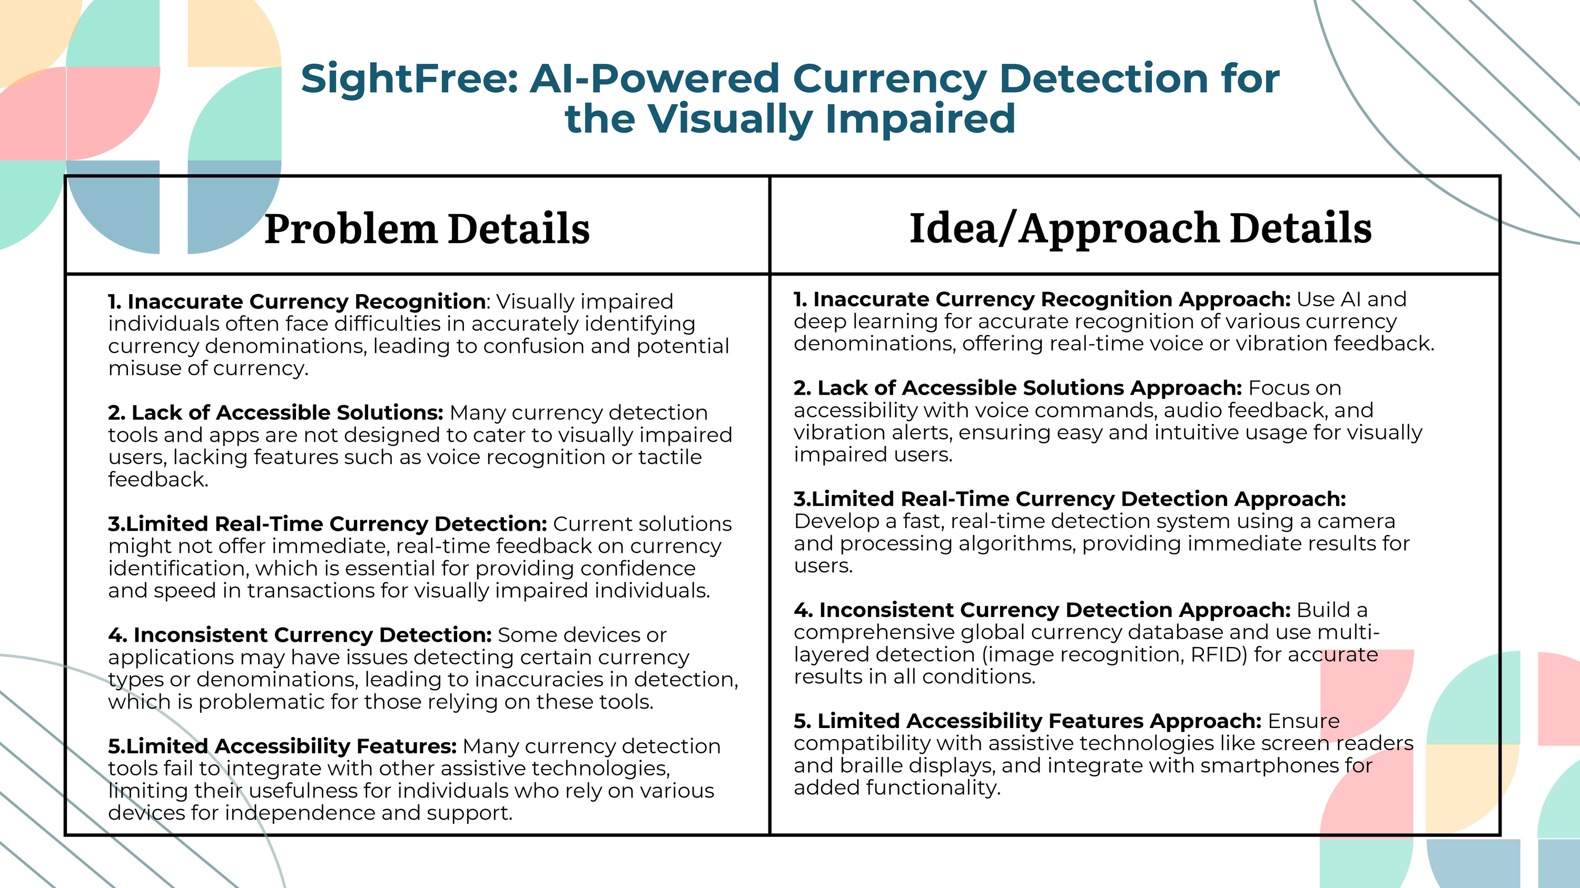

Slide 4
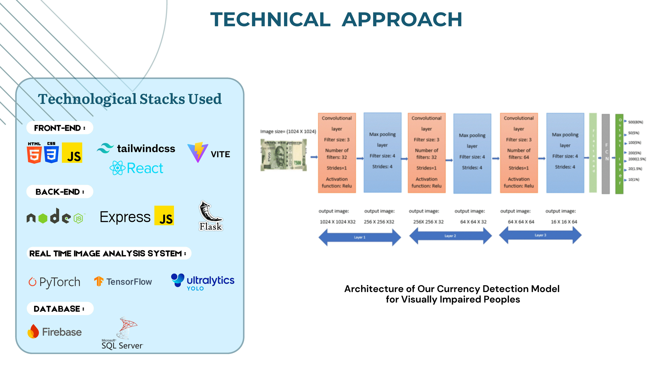


Slide 5
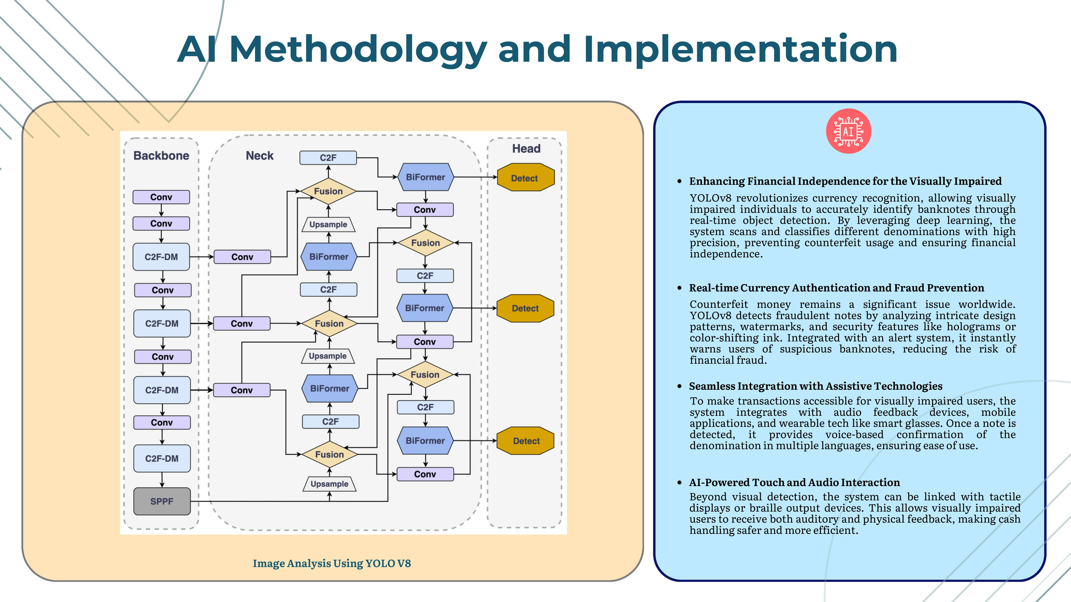

Slide 6
